Slide 1
Fluid-Solid coupling using SPH method
Tianyuan Wu

Slide 2
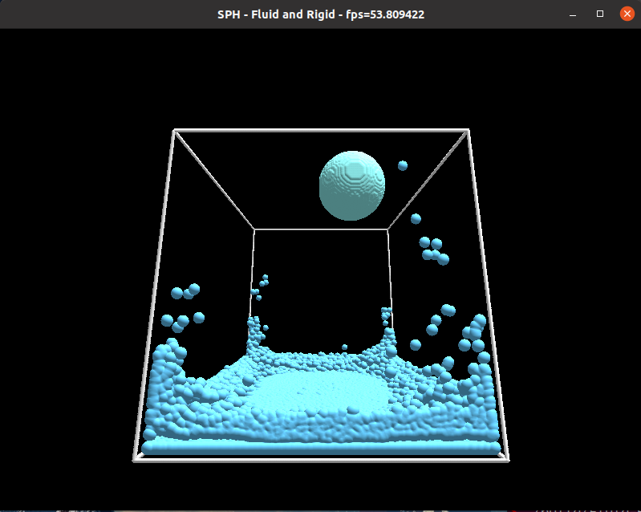
Overview
Basics of fluid simulation
SPH method
Implementation
Results & Evaluation

Slide 3
Fluid simulation
Eulerian approach
Lagrangian approach

Slide 4
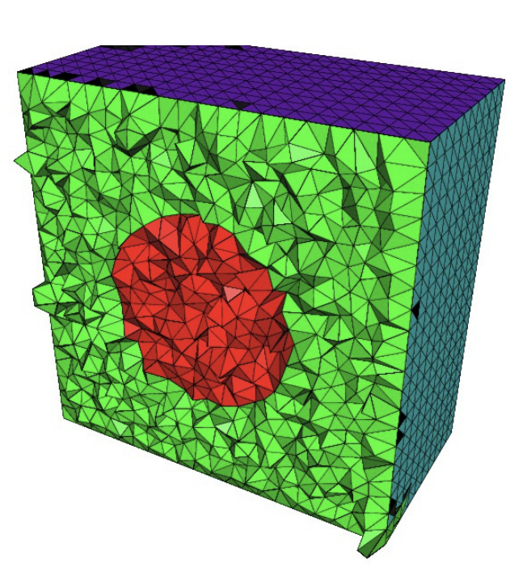
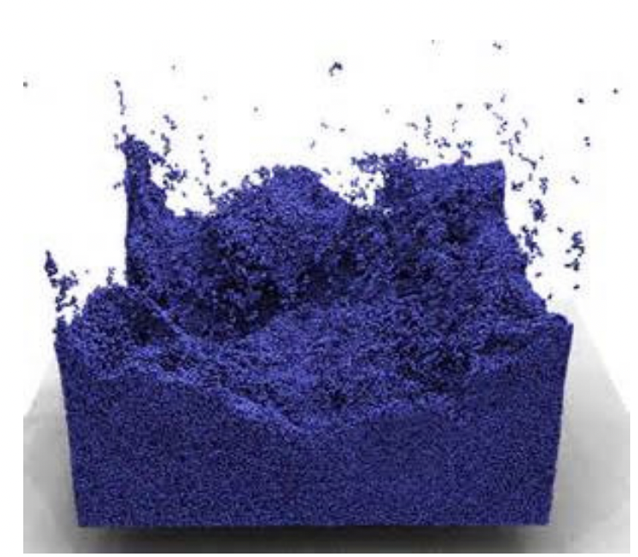
Methods of Lagrangian and Eulerian approach
Finite volume method Particle based method

Slide 5
Dynamics of particles
By Newton’s second law
Acceleration

Slide 6
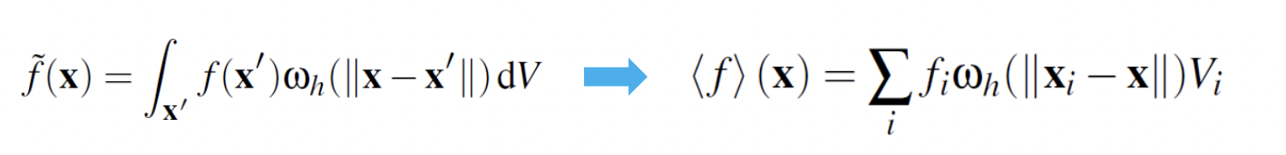
SPH method - Approximation
SPH approximation
Discretize the integral into a sum over all sample points
Influence of other particles

Slide 7
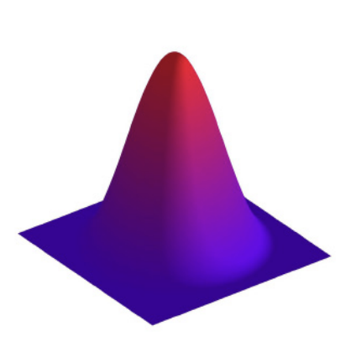
SPH method – Kernel function
Kernel function – ω(r, h)
Where

Slide 8
SPH method
The acceleration can be calculated as
Finally, we can observe that

Slide 9
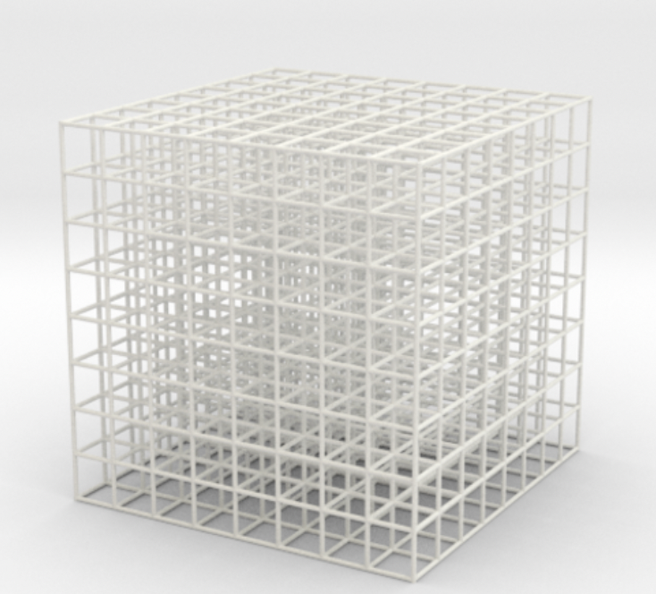
Implementation – Reduction of complexity
Time complexity of SPH
Roughly O(n²) without optimization
Where n is the number of particles
We may need to calculate interaction
between each particle and all other particles
Spatial hash table
Split the simulation space into cubic mesh
Index each cube to be the key of the hash table
Value of key is the particles in this cube

Slide 10

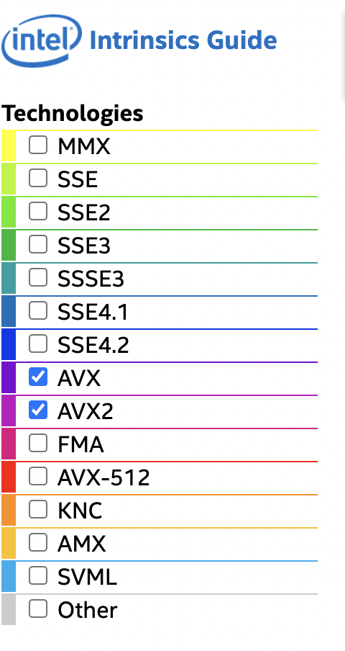
Implementation – Parallelism
SPH method is good for parallelism
Calculation of particles is individual
OpenMP® – Thread level parallelism
Open multi-processing library
Shared memory multi-threading
We can use simple #pragma instruction for parallelism
Calculation of particle dynamics can be done parallelly
SIMD – ISA level parallelism
Intel® SSE / AVX intrinsics
Calculation of fluid attributes are implemented by
SIMD instructions

Slide 11
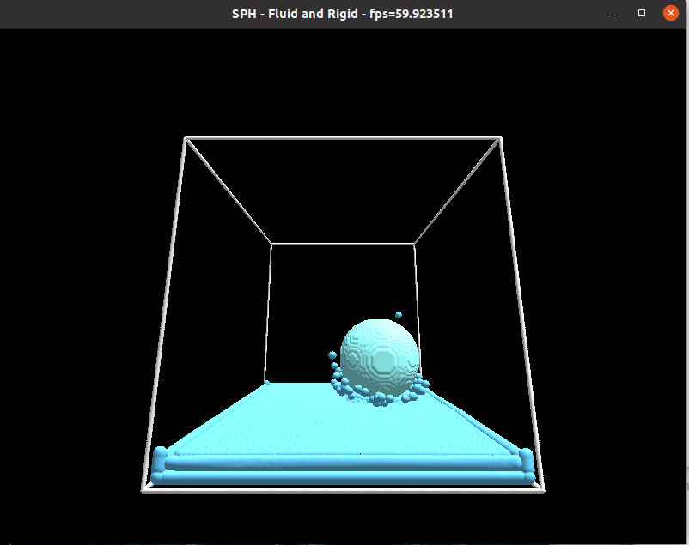
Implementation – coupling
Two-way coupling
When collision between rigid bodies and
particles detected, update their velocity
by conservation of momentum
When we decrease the mass of the ball or
increase the density of the liquid, we can
observe the ball floating on the liquid

Slide 12
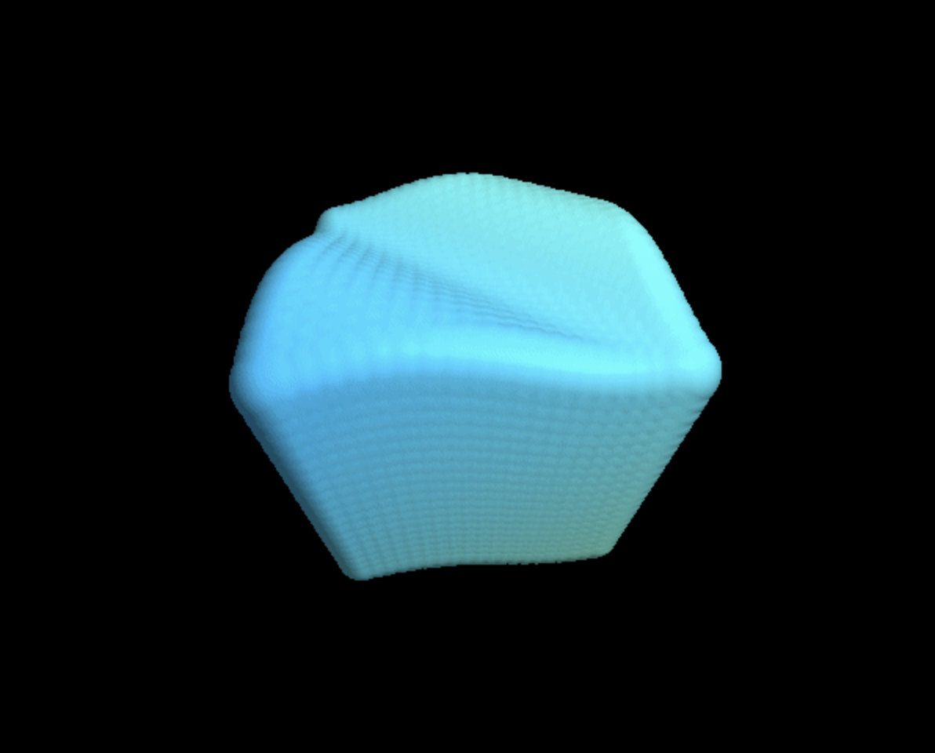
Implementation - Rendering
Rendering is based on the paper
Adams, B., Lenaerts, T. & Dutrè, P. (2006). Particle Splatting: Interactive Rendering of Particle-Based Simulation Data
GitHub repo: https://github.com/MoleTrooper/splatter

Slide 13
Implementation – Interaction
Keyboard
Key F: full view
Key N: normal of vertices
Key D: depth vies
Key Space: pause
Key Up: add particles to system
Key Down: Enable the ball drop down
Mouse cursor: change the direction of view

Slide 14
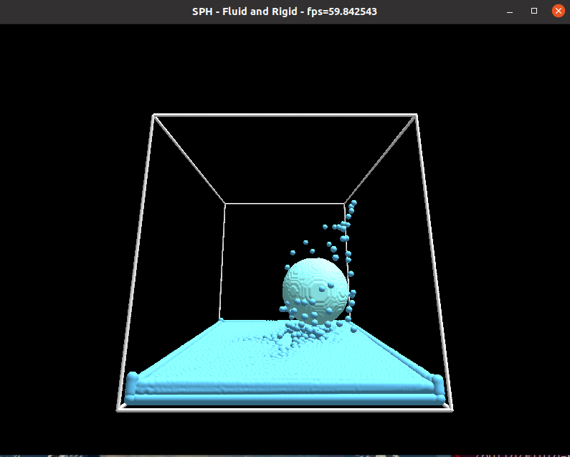
Results - Demo

Slide 15
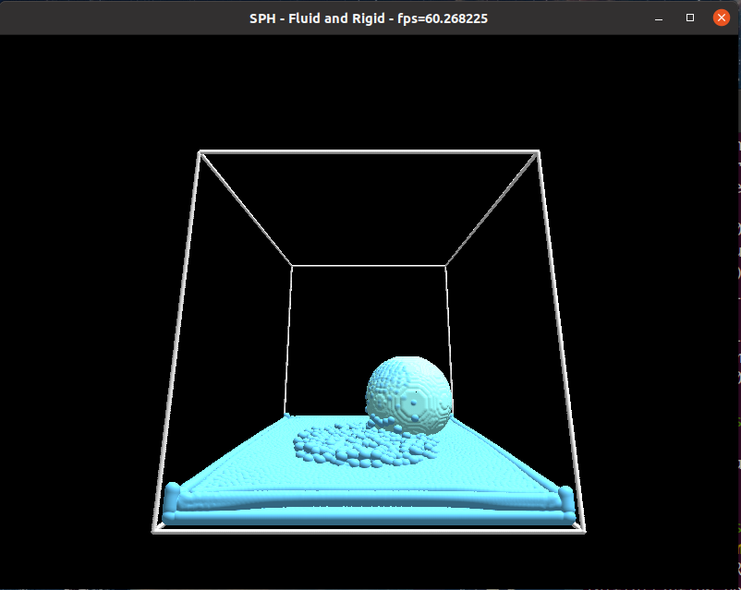
Results - Demo

Slide 16
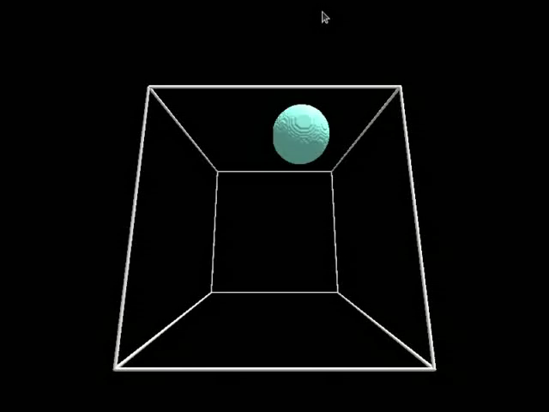
Results – Video

Slide 17
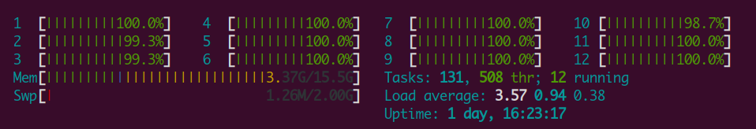
Results – Evaluation
Evaluation platform
Ubuntu® 20.04 LTS, GCC 9.2
OpenGL 3.3.0
Intel® i7-8700k CPU, 32GB memory (6 core, 12 threads)
Performance
1 thread (no parallelism)
8-12 fps with ~20,000 particles
6 core with 12 threads
30-50 fps with ~20,000 particles
CPU exploitation is closed to 100%

Slide 18
Thanks

